Slide 1
TOPIC: FLAME PHOTOMETER
Dr. K. MAHMOODAH PARVEEN
ASSISTANT PROFESSOR
PG & RESEARCH DEPARTMENT OF CHEMISTRY
JAMAL MOHAMED COLLEGE
TRICHY-20

Slide 8
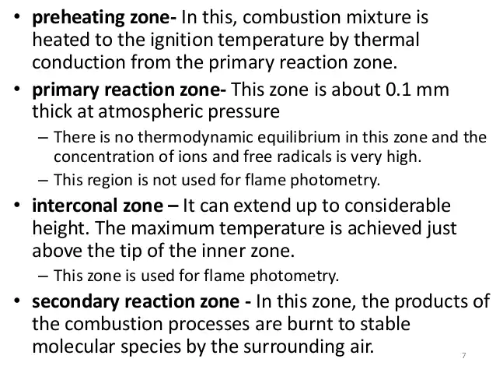

Slide 22
THANK YOU !

